Slide 1


Y.A.C.H.T
HRLYTICS
Yet Another College Hackathon Team

Slide 2

Content
01
02
03
04
05
Our Team
About HRlytics
Concept
Features Provided
Future Plans

Slide 3


OUR TEAM
Vishnu M P
Tanush T M
Viswa K
Role - AI Engineer
Role - AI Engineer
Role - Backend Engineer
Varun Kumar G S
Vignesh M
Saieed M
Role - UI/UX Designer
Role - Database Engineer
Role - Frontend Engineer
01

Slide 4
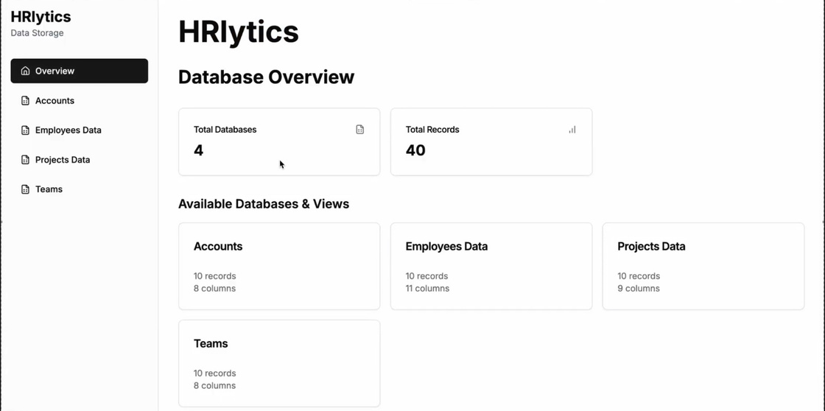

ABOUT HRLYTICS
HRlytics makes HR processes smarter and more efficient. With AI-driven hiring, performance tracking, and clear data visuals, it helps companies make better decisions and improve workforce management.
What sets HRlytics apart is Donna, our AI-powered visual assistant, designed to provide real-time HR insights, assist in talent acquisition, and streamline administrative processes. Whether you're a startup or a large enterprise, HRlytics ensures your workforce is managed with intelligence and efficiency.
01

Slide 5
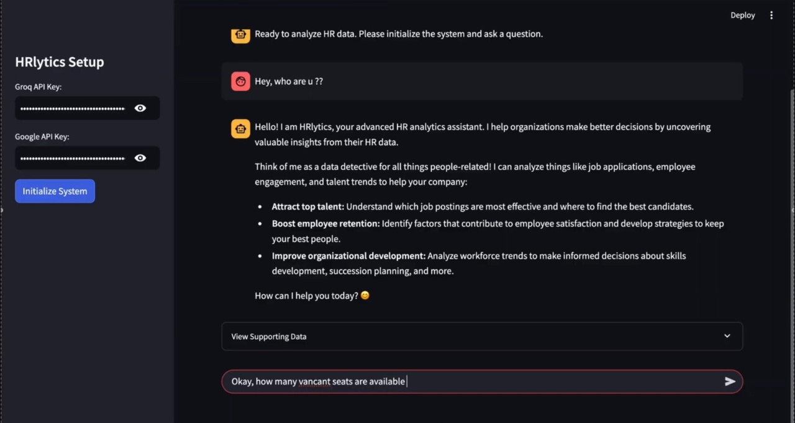
CONCEPT
The concept behind HRlytics is simple: Make HR smarter and more efficient with AI-driven insights. Traditional HR management is time-consuming, error-prone, and lacks real-time insights.

Slide 6

FEATURES

Slide 7


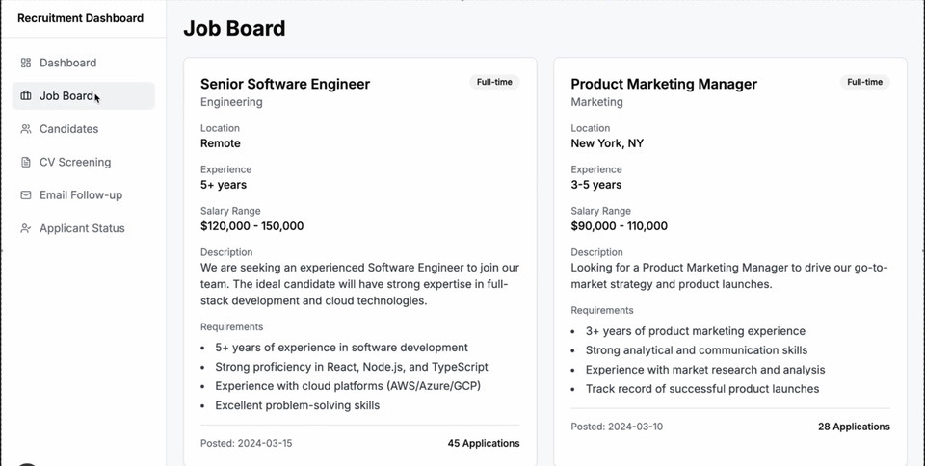

Smart Hiring
AI-driven recruitment process that filters and ranks the best candidates based on their qualifications, experience, and suitability.
1
Employee Management
2
Real-time performance tracking using interactive charts and data visualization tools to measure employee productivity.

Slide 8
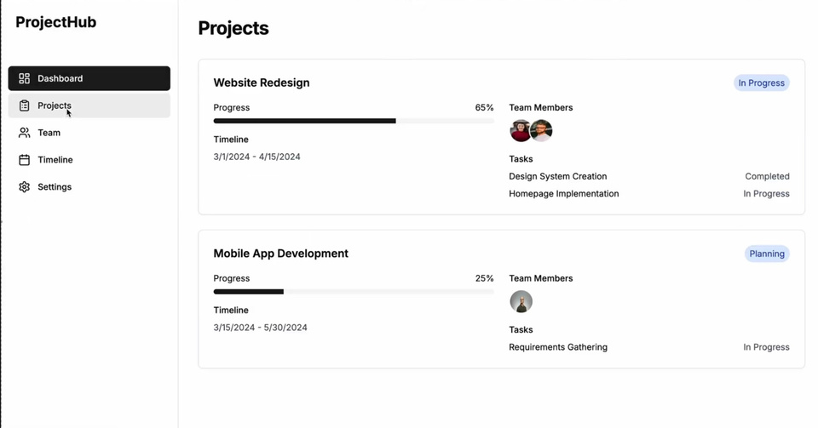


Project Management
Donna
Streamline task tracking, resource allocation, and team collaboration.
Donna, our virtual HR assistant, helps with employee queries, analytics, and recommendations, making HR management smoother.
3
4

Slide 9

FUTURE PLANS
Increase Scalability
Implement TTS and STT
Connecting BS Systems
Enhance system capacity to manage higher traffic and data loads.
Improve speech interaction for better user engagement.
Connect with external systems for seamless data integration.
01

Slide 10
01
THANK YOU!!
~FOR YOUR ATTENTION

